Slide 1

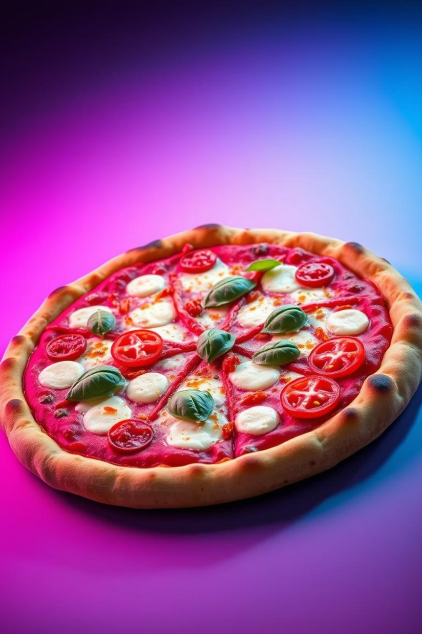

Pizzato Mania
Your Slice of Digital Delight
Team Name:- NASA
1 . Nitesh Singh
Anuj Shukla
Siddhi Parhad
Aditi Shinde
Notes:
1

Slide 2
Pizzato Mania: Revolutionizing Pizza Delivery
Welcome to Pizzato Mania, where culinary excellence meets cutting-edge convenience. We are an innovative online platform dedicated to bringing fresh, delicious pizza directly to your door with unparalleled speed and a seamless ordering experience. Our mission is to transform your pizza cravings into instant satisfaction, ensuring every bite is a delight.
Notes:
2

Slide 3




Our Core Strengths
Blazing Fast Delivery
Finest, Freshest Ingredients
Intuitive User Experience
Our optimized logistics and dedicated delivery network ensure your pizza arrives hot and fresh, every time. We pride ourselves on efficiency from oven to doorstep.
Our website is designed for simplicity and ease of use, making your ordering process smooth, enjoyable, and hassle-free from start to finish.
We source only premium, high-quality ingredients, from farm-fresh vegetables to savory meats and authentic cheeses, guaranteeing superior taste and quality.
Notes:
3

Slide 4
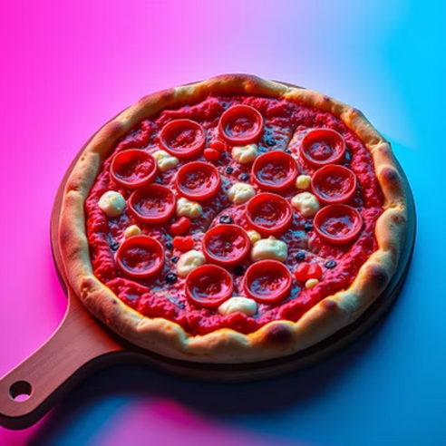
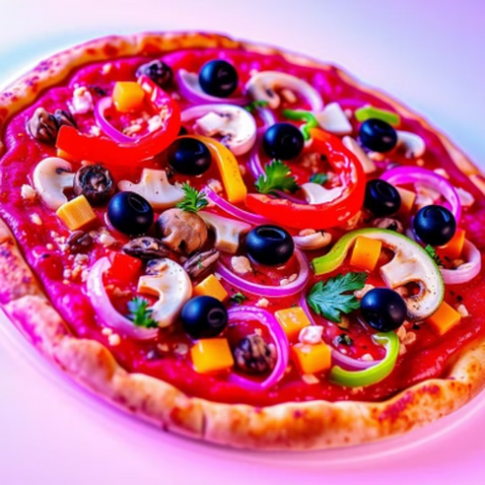
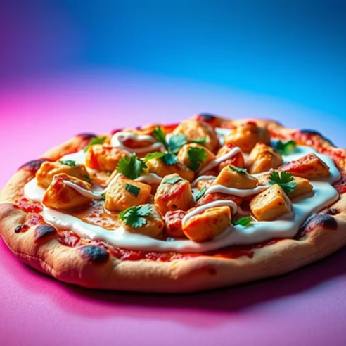
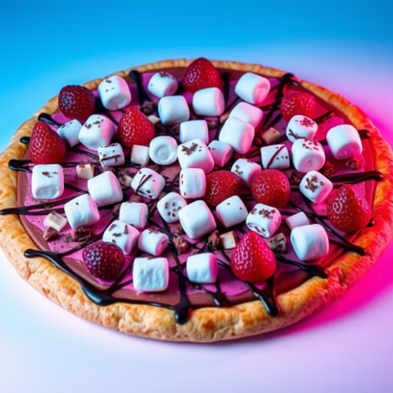
Savor Our Signature Menu
Explore our diverse menu featuring classic favorites, vegetarian delights, and gourmet specialties. Each pizza is crafted with passion and precision to satisfy every palate.
Notes:
4

Slide 5




Ordering Made Simple
Browse & Select
Customize Your Order
Effortlessly explore our enticing menu and choose your perfect pizza from a wide array of options.
Tailor your pizza with preferred crusts, sauces, and toppings to create a personalized masterpiece.
Secure Checkout
Track Your Delivery
Complete your purchase swiftly and securely with multiple convenient payment options.
Monitor your order in real-time, from preparation to its arrival at your doorstep.
Notes:
5

Slide 6
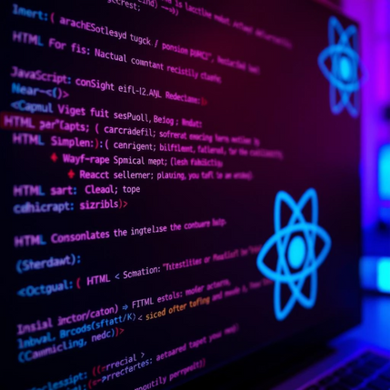
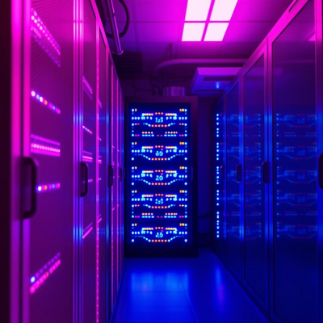
Robust Technology Underneath
Backend
Frontend
Powered by Node.js, our backend handles robust data processing, secure transactions, and efficient order management.
Built with React.js, our frontend ensures a dynamic, responsive, and engaging user interface, providing a smooth navigation experience.
Deployment
Hosted on Vercel, our platform guarantees high availability, scalability, and lightning-fast load times for optimal performance.
Notes:
6

Slide 7
Our Distinct Edge
Hyper-Local Focus
Sustainable Practices
Community Engagement
We leverage advanced mapping and routing to ensure the fastest delivery times within specific geographic zones.
Committed to eco-friendly operations, we use recyclable packaging and optimize delivery routes to reduce our carbon footprint.
Pizzato Mania actively partners with local farmers and suppliers, strengthening community ties and supporting local economies.
Notes:
7

Slide 8
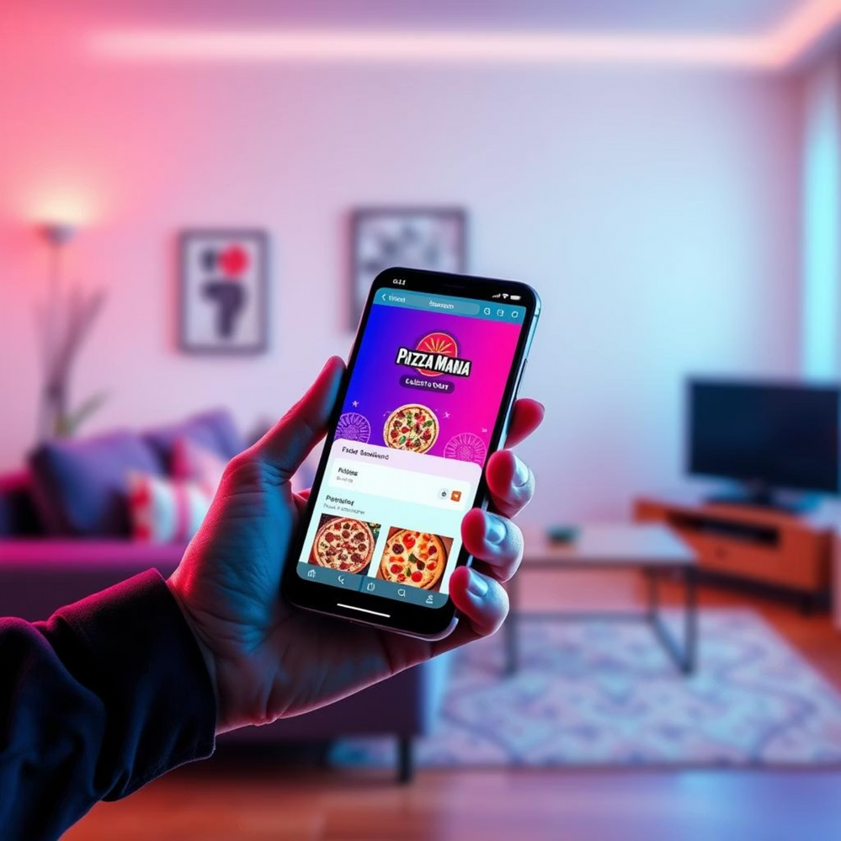
Exceptional Customer Experience
Intuitive UI: Our clean, clutter-free interface simplifies the entire ordering journey.
Mobile-First Design: Seamless experience on any device, perfect for ordering on the go.
Dedicated Support: Our customer service team is always ready to assist, ensuring satisfaction.
"Pizzato Mania has transformed my pizza nights. Fast, fresh, and incredibly easy to use!" - A Satisfied Customer
Notes:
8

Slide 9
Future Enhancements & Growth
Expanded Menu Offerings
AI-Powered Personalization
Introducing new items like gluten-free options, custom pasta dishes, and gourmet salads to diversify choices.
Implementing AI to offer tailored pizza recommendations based on past orders and preferences.
Geographic Expansion
Loyalty Rewards Program
Planning to extend our delivery service to new cities and neighborhoods, bringing Pizzato Mania to more homes.
Launching a points-based system to reward our loyal customers with exclusive discounts and free items.
Notes:
9

Slide 10
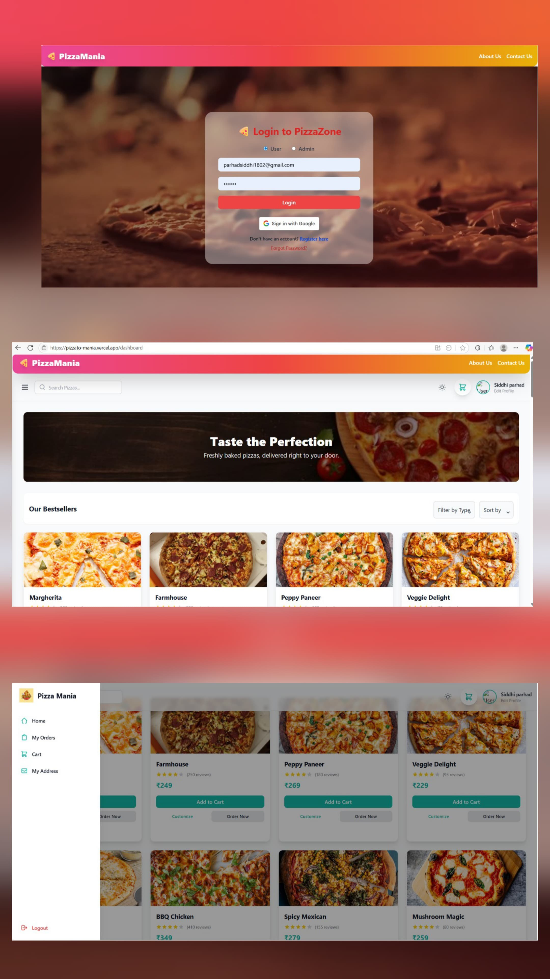
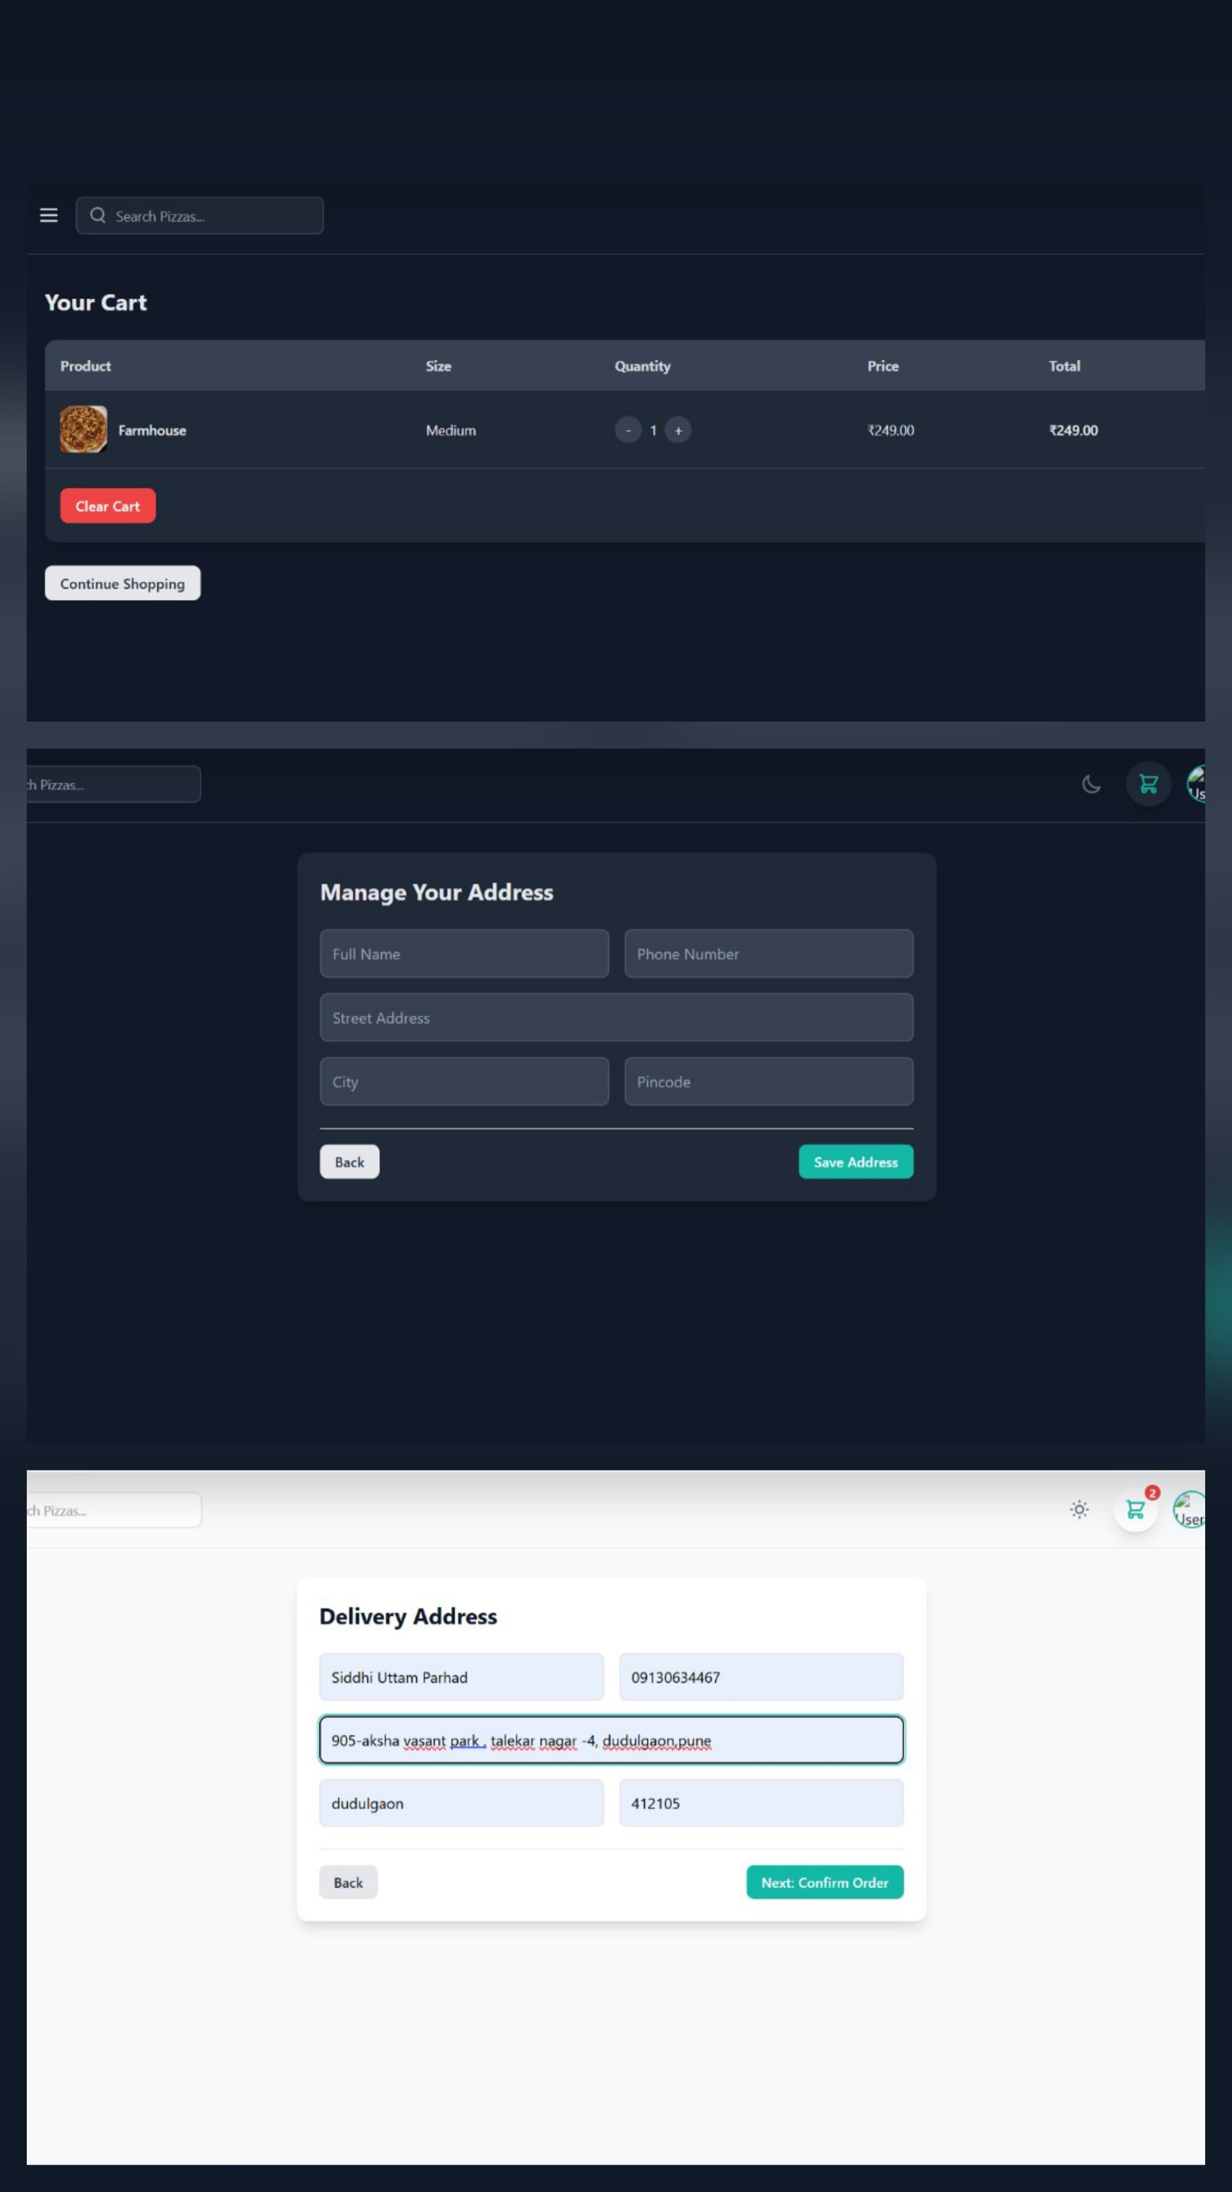
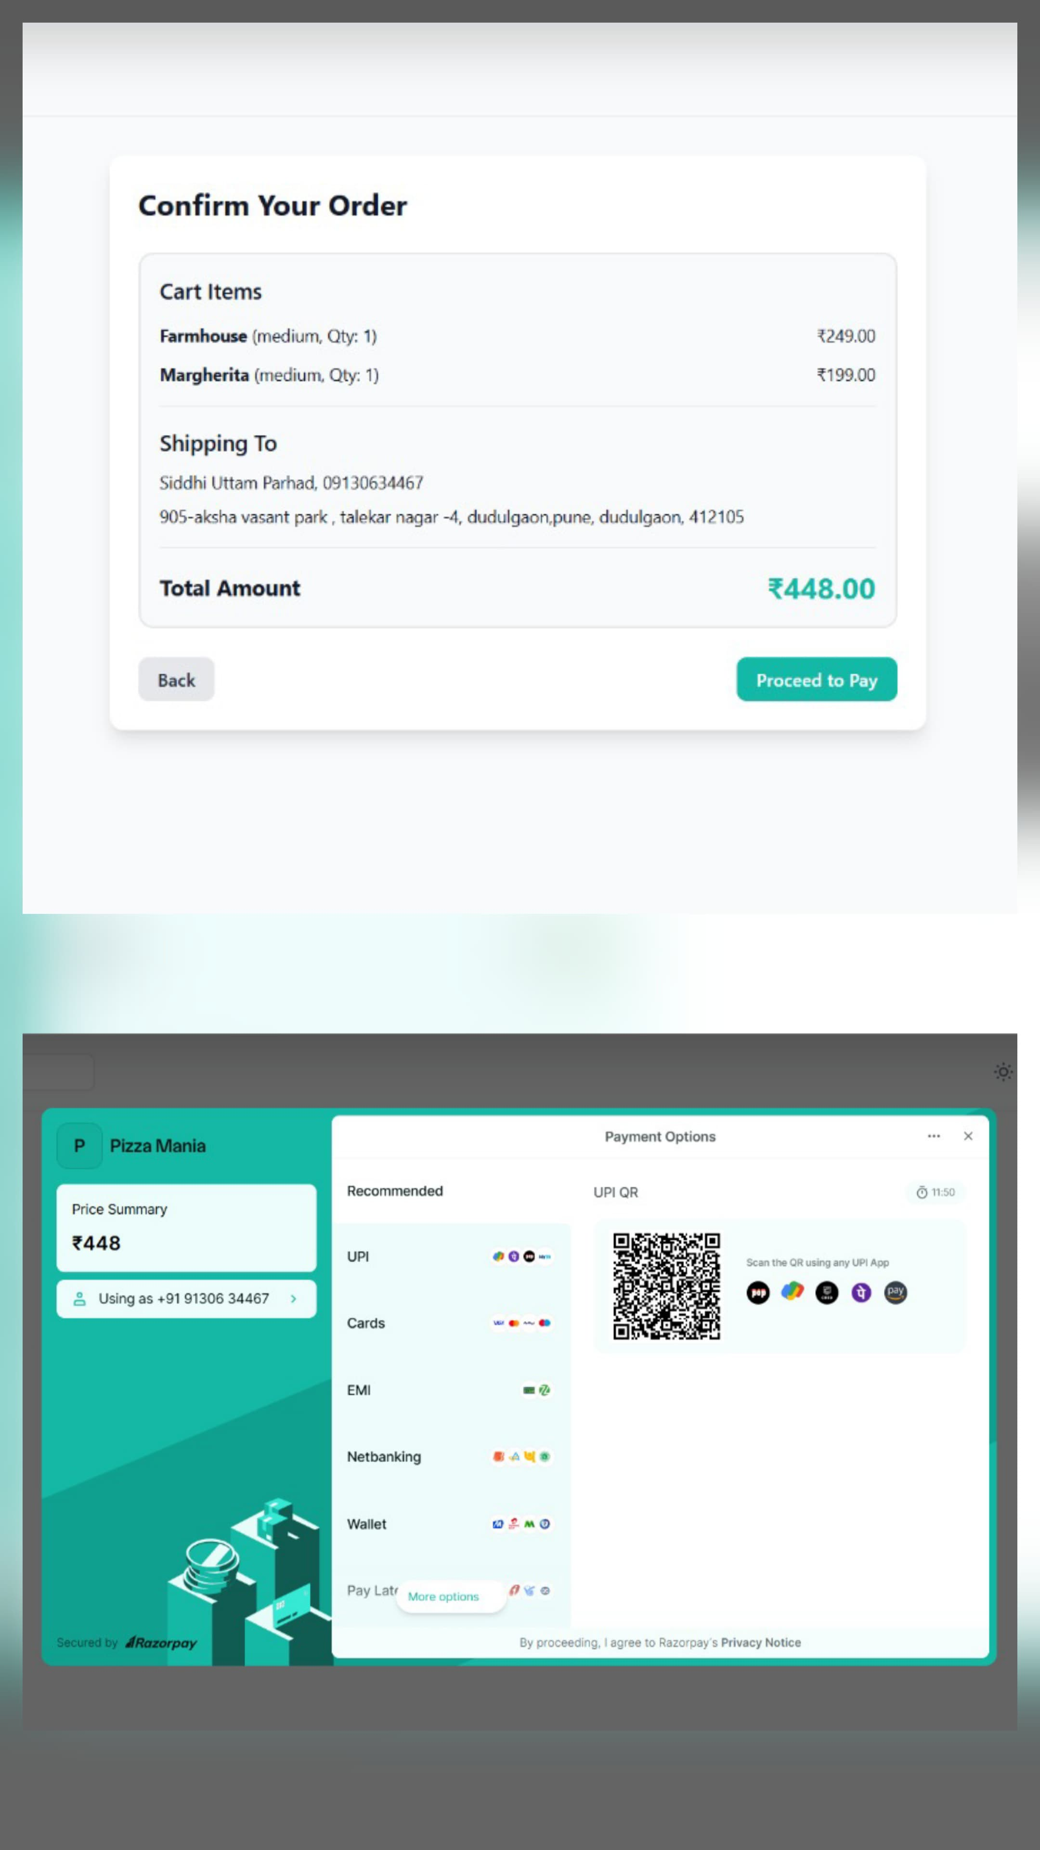
App Look Like This :

Slide 11
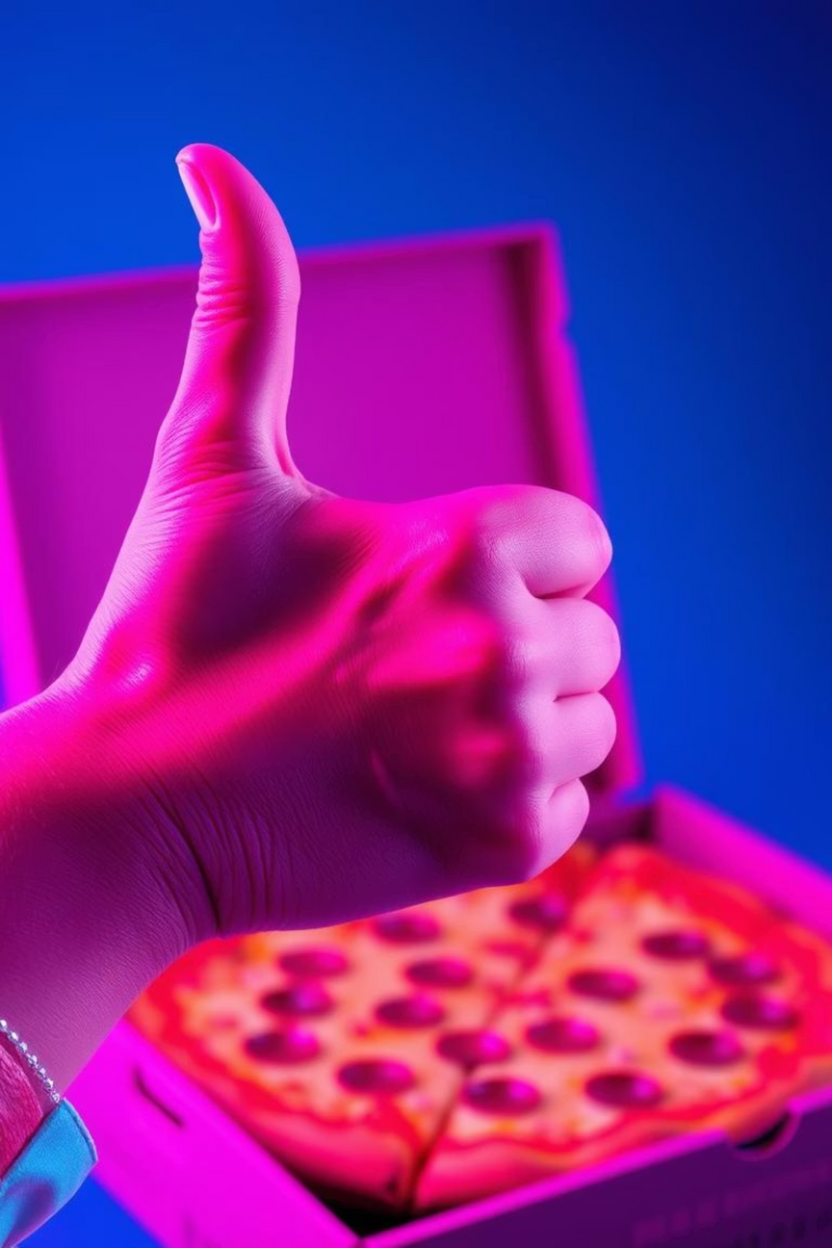
Thank You!
Experience the future of pizza delivery with Pizzato Mania.
Visit us at : https://pizzato-mania.vercel.app/ -
Notes:
10

